Slide 1
What is apache - tomcat
The Apache Tomcat software is an open source implementation of the Java Servlet, JavaServer Pages, Java Expression Language and Java WebSocket technologies. The Java Servlet, JavaServer Pages, Java Expression Language and Java WebSocket specifications are developed under the Java Community Process.
Server an instance of tomcat web application Server.
Service manages connectors bet Client and Server Components.
Tomcat requires Java to be installed on the server so that any Java web application code can be executed. We can satisfy that requirement by installing OpenJDK with apt-get.

Slide 2
Install java for Tomcat
Tomcat requires Java to be installed on the server so that any Java web application code can be executed. We can satisfy that requirement by installing OpenJDK with apt-get.
# sudo add-apt-repository ppa:webupd8team/java
# sudo apt-get update
# sudo apt-get install oracle-java8-installer
Ok
yes
# java –version

Slide 3
Set java path for Tomcat
# vim /etc/environment
JAVA_HOME="/usr/lib/jvm/java-8-oracle"
export JAVA_HOME
Lastly, reload the system PATH with the following command :
# . /etc/environment
or
# source /etc/environment
Check java path :-
# echo $JAVA_HOME

Slide 4
Install Tomcat
# mkdir /opt/tomcat
# cd /opt/tomcat
Select Tomcat Version from following link.I am select in tomcat9 version and download tar.gz file. https://tomcat.apache.org/download-90.cgi
# wget http://www-us.apache.org/dist/tomcat/tomcat-9/v9.0.1/bin/apache-tomcat-9.0.1.tar.gz
# tar xzf apache-tomcat-9.0.1.tar.gz

Slide 5
Start Tomcat
Start the tomcat :-
# cd /opt/tomcat/apache-tomcat-9.0.1/bin
# ./catalina.sh start
0r
# ./starttup.sh
Check the tomcat Process :-
# netstat -antp | grep LISTEN
tcp6 0 0 127.0.0.1:8005 :::* LISTEN 16932/java
tcp6 0 0 :::8009 :::* LISTEN 16932/java
tcp6 0 0 :::8080 :::* LISTEN 16932/java

Slide 6
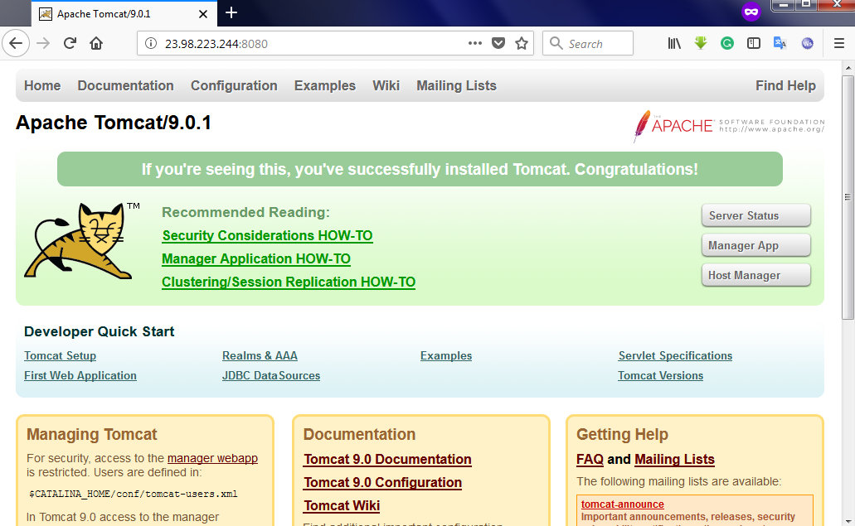
Access Tomcat UI
Open browser and type :- <IP address>:8080 for access tomcat home page.
For example :- http://23.98.223.244:8080/

Slide 7
Deploye application over tomcat
We want to deploye any application war file. Foe ex- geoserver.war file.
First you want to download .war file application.
Download and extract geoserver.war file From following ways.
# get https://excellmedia.dl.sourceforge.net/project/geoserver/GeoServer/2.7.6/geoserver-2.7.6-war.zip
# apt-get install unzip
# unzip geoserver-2.7.6-war.zip geoserver.war
Move to tomcat/webapps folder :-
# mv geoserver.war /opt/tomcat/apache-tomcat-7.0.54/webapps/
After that restart the tomcat service

Slide 8
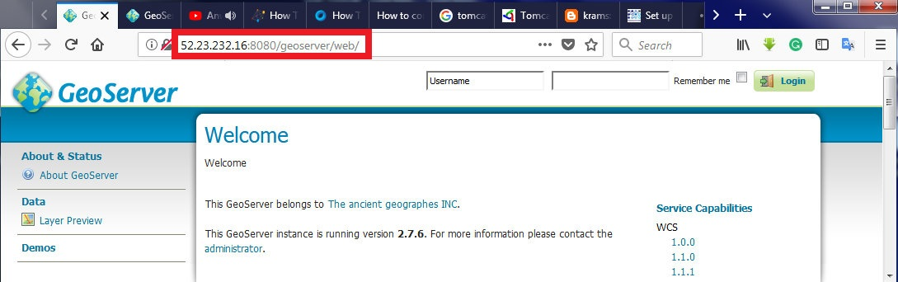
Check Deployed application over tomcat
Open Browser and type :- <IP address>:8080/geoserver/web
For access Geo-Server UI over tomcat.
For Example :- http://52.23.232.16:8080/geoserver/web/

